Slide 1

Scalpel, Scope, or Syringe?
The Future of Obesity Therapy — Surgery, Endoscopy, and Pharmacotherapy in Comparison
PD Dr. med. Marko Kraljević
Notes:
Good afternoon, everyone.
Today, I would like to discuss a question that is becoming increasingly relevant in our daily clinical practice: Scalpel, scope, or syringe?
With the rapid development of anti-obesity medications and endoscopic procedures, bariatric surgery is no longer the only effective intervention for treating obesity.
The question is therefore not simply which treatment achieves the greatest weight loss, but rather: How do we select the right treatment for the right patient?"

Slide 2
Introduction
Obesity care is in transition: bariatric surgery, endoscopic procedures, and GLP-1/GIP pharmacotherapy increasingly compete and complement one another. Current evidence shows no single “winning procedure”, but rather calls for a differentiated, patient-specific strategy.
Scalpel
Bariatric & metabolic surgery
Syringe
GLP-1/GIP pharmacotherapy
Scope
Endoscopic procedures
18. September 2026
Notes:
Obesity care is currently undergoing a major transition.
Bariatric surgery, endoscopic therapies, and GLP-1 and GIP-based medications are increasingly competing with one another, but they can also complement each other.
Each approach has specific advantages and limitations. Surgery offers substantial and durable weight loss, medication provides an effective non-surgical option, and endoscopy offers an intermediate approach with less invasiveness.
Importantly, we should avoid thinking in terms of a single winning treatment. Instead, our goal should be to develop a differentiated, patient-specific strategy that considers metabolic disease, treatment preferences, risks, and long-term adherence.

Slide 3
Scalpel — Bariatric & Metabolic Surgery
The gold standard for durable weight loss
Greatest, most durable weight loss: ~23–27% total weight loss (TWL) at 10 years, with superior T2D remission (Pipek et al., Sci Rep 2024)
Network meta-analysis (30 RCTs, n=20,015): surgery significantly outperforms GLP-1 agonists in %TWL, BMI, waist circumference and HbA1c — except vs. tirzepatide alone (Sabatella et al., Obesity 2026)
Two-center cohort (n=44,025): sleeve gastrectomy 22–24% TWL, RYGB 28–30% TWL, vs. 7–11% (tirzepatide) and 5–7% (semaglutide) (Brown et al., Obesity 2026)
Despite higher upfront cost, surgery has lower out-of-pocket costs than continued GLP-1 therapy over 24 months (Rivero-Moreno et al., JLAST 2026)
Bariatric surgery
23–27%
Total weight loss (TWL) at 10 years — plus superior T2D remission and lower cardiovascular mortality
18. September 2026
Notes:
Let us start with bariatric surgery.
Surgery remains an important reference point in obesity treatment, particularly because of its long-term effectiveness.
The data presented here demonstrate that bariatric surgery can achieve approximately 23 to 27 percent total weight loss even at 10 years, alongside superior diabetes remission.
In a network meta-analysis including 30 randomized controlled trials, surgery significantly outperformed GLP-1 receptor agonists for several outcomes, including total weight loss, BMI, waist circumference, and HbA1c—with the exception of comparisons against tirzepatide alone.
The cohort data also illustrate differences between procedures. RYGB achieved approximately 28 to 30 percent total weight loss, compared with 22 to 24 percent after sleeve gastrectomy.
However, we must also consider the invasiveness, perioperative risks, and the fact that surgery represents a structural intervention.
So, while surgery remains highly effective, effectiveness alone should not determine our treatment decision.

Slide 4
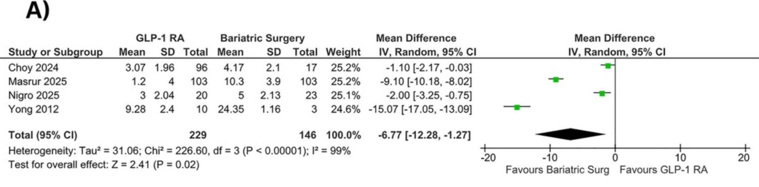
SURGERY VS. GLP-1 RA: PANEL A
absolute change in BMI (kg/m²) at 6 months
Tahir et al. DOM. 2026
18. September 2026
4
Notes:
Let us look at the comparative evidence in more detail.
This systematic review and meta-analysis, published in Diabetes, Obesity and Metabolism in 2026, included 15 studies and more than 20,000 participants.
The first panel shows weight loss at six months. Bariatric surgery was associated with a greater mean weight reduction, approximately 12 kilograms more than GLP-1 receptor agonists.
MD −6.77 kg/m2; p = 0.02
It is important to note that heterogeneity was very high, suggesting substantial differences between the included studies.
15 studies with 20,594 participants (4 RCTs and 11 observational studies).

Slide 5
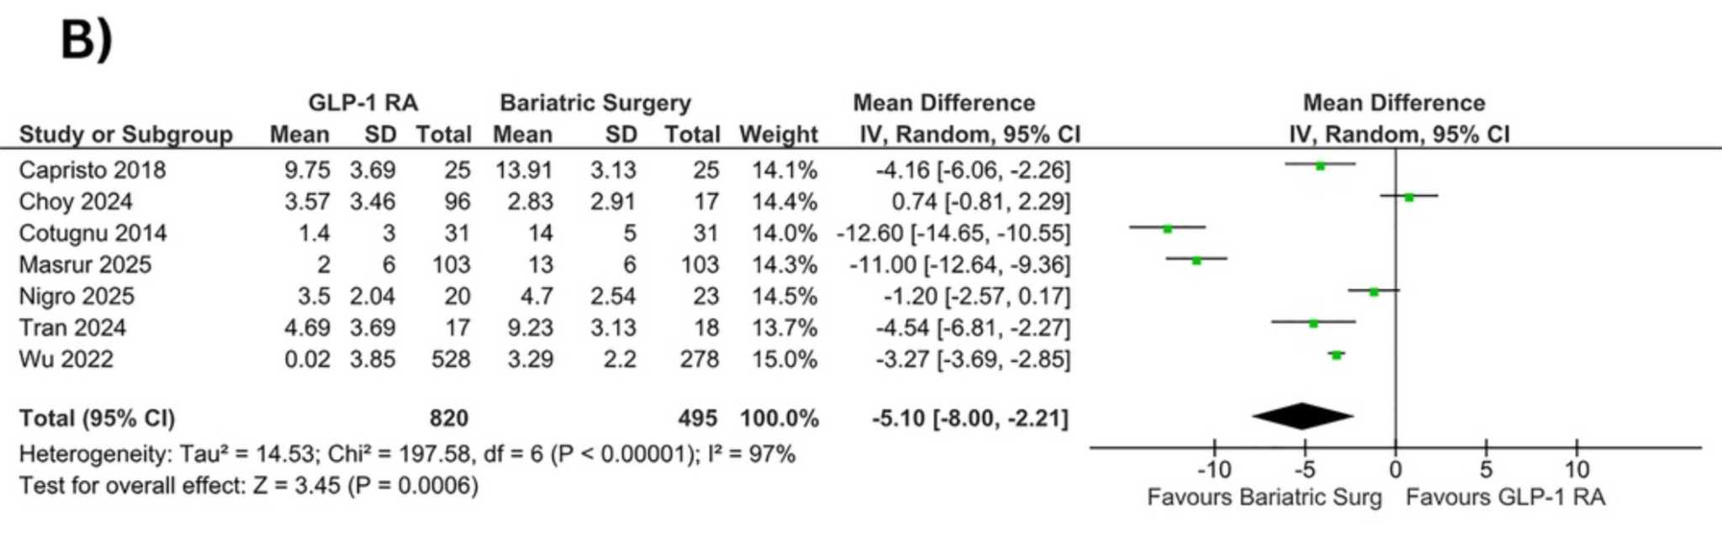
SURGERY VS. GLP-1 RA: PANEL B
absolute change in BMI (kg/m²) at ≤ 1 year
Tahir et al. DOM. 2026
18. September 2026
5
Notes:
At one year, the difference becomes statistically significant.
Bariatric surgery was associated with approximately 17 kilograms greater weight loss compared with GLP-1 receptor agonists.
MD −5.10 kg/m2; p < 0.001
However, we should interpret this result carefully. The analysis included both randomized and observational studies, and heterogeneity remained very high.
Therefore, the findings demonstrate an association in favour of surgery, but they do not necessarily establish the same magnitude of effect for every patient or every surgical procedure.

Slide 6
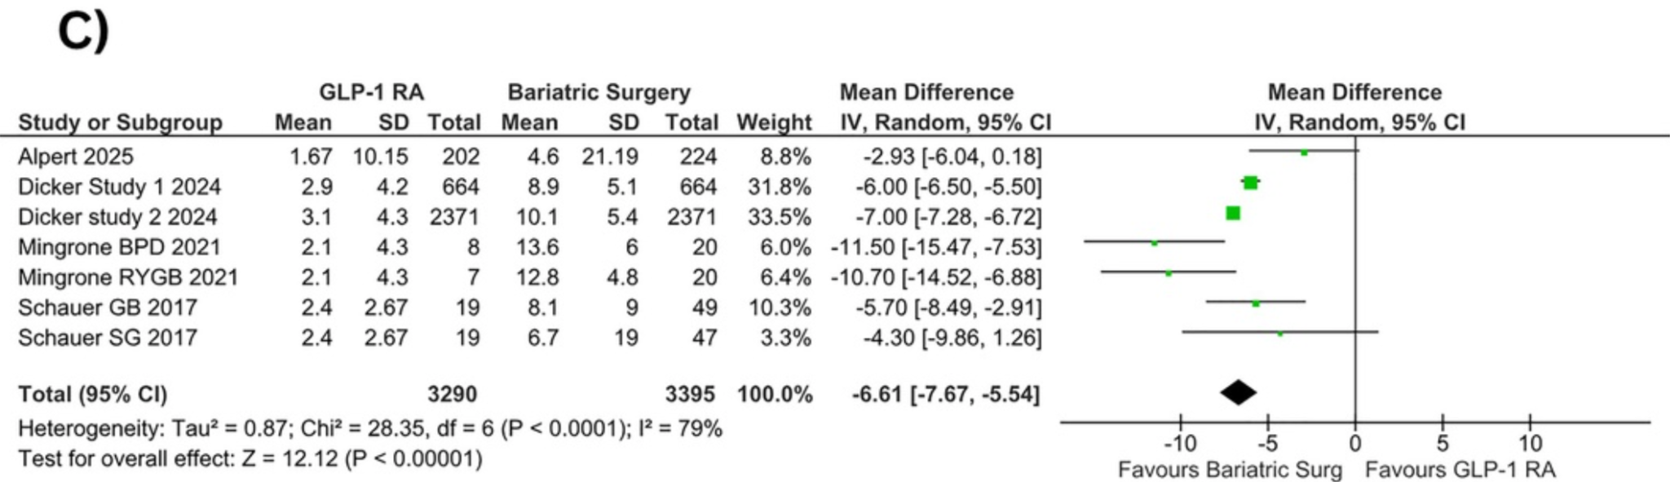
SURGERY VS. GLP-1 RA: PANEL C
absolute change in BMI (kg/m²) at > 1 year
Tahir et al. DOM. 2026
18. September 2026
6
Notes:
The most pronounced difference was observed beyond one year.
Here, bariatric surgery was associated with approximately 20 kilograms greater weight reduction than GLP-1 receptor agonists.
MD −6.61 kg/m2;p < 0.001
This suggests that the treatment gap may increase over longer follow-up periods.
However, this is not a direct comparison of modern high-dose tirzepatide with surgery. The included studies used different GLP-1 receptor agonists, doses, surgical procedures, and follow-up periods.

Slide 7
Syringe — GLP-1/GIP Receptor Agonists
Closing the efficacy gap with surgery
SURMOUNT-1: tirzepatide 15 mg achieved 20.9% weight loss at 72 weeks
SURMOUNT-5 head-to-head: tirzepatide superior to semaglutide (‒20.2% vs. −13.7%) (Aronne et al., NEJM 2025)
SELECT trial: semaglutide significantly reduces cardiovascular risk in patients with obesity/overweight and established CVD (HR 0.80) (Lingvay et al., Lancet 2024)
Limitation: substantial weight regain after discontinuation (up to half within one year); high cost limits cost-effectiveness (Hwang et al., JAMA Health Forum 2025; Schweitzer, JAMA 2025)
20.9%
Weight loss with tirzepatide 15 mg at 72 weeks (SURMOUNT-1) — plus reduced cardiovascular risk
18. September 2026
Notes:
Moving to pharmacotherapy, the efficacy gap between medication and surgery is becoming narrower.
In SURMOUNT-1, tirzepatide at a dose of 15 milligrams achieved approximately 20.9 percent weight loss at 72 weeks.
Furthermore, SURMOUNT-5 demonstrated greater weight loss with tirzepatide compared with semaglutide in a head-to-head comparison.
These results represent an important development because they offer patients a highly effective non-surgical treatment option.
We should also recognize that medications can provide benefits beyond weight loss. In the SELECT trial, semaglutide reduced cardiovascular events in patients with overweight or obesity and established cardiovascular disease.
However, pharmacotherapy has important limitations. Gastrointestinal adverse effects, treatment costs, and the potential for weight regain after treatment discontinuation must be considered.
This means that prescribing the medication is not the end of treatment. We need a long-term strategy for maintaining weight loss and managing chronic disease.

Slide 8
Scope — Endoscopic Bariatric Therapies
A minimally invasive middle ground
Intragastric balloons, endoscopic sleeve gastroplasty (ESG) and POSE/POSE 2.0 sit between lifestyle intervention and surgery or pharmacotherapy (Kermansaravi et al., Sci Rep 2024)
ESG achieves ~15–20% total body weight loss (TBWL) at 12–24 months with a low severe-AE rate (1.25–2.2%), outperforming intragastric balloons (Mrad et al., GIE 2025; Huang et al., Sci Rep 2026)
GRADE network meta-analysis (139 RCTs): endoscopic procedures — except ESG — are inferior to newer obesity medications; semaglutide/tirzepatide were non-inferior to surgery short-term (De Luca et al., Obesity 2026)
UK cost-effectiveness analysis: ESG is cost-effective vs. semaglutide in obesity grade I/II; semaglutide is dominant over intragastric balloons (Albon et al., HTA 2025)
«Not a compromise — a genuine third option.»
Endoscopic bariatric therapy fills the gap between lifestyle change and surgery or chronic medication
18. September 2026
Notes:
Endoscopic procedures represent a third therapeutic option.
They may be particularly relevant for patients who are not ready for surgery, who prefer a less invasive approach, or for whom chronic pharmacotherapy is not suitable or desired.
Endoscopic sleeve gastroplasty, or ESG, achieves approximately 15 to 20 percent total body weight loss at 12 to 24 months in the data presented here.
Compared with intragastric balloons, ESG appears to offer greater and more sustained weight loss, while maintaining a relatively low rate of severe adverse events.
Of course, endoscopic procedures are not risk-free, and their long-term effectiveness and durability need to be evaluated in the context of individual patients.
I would therefore describe endoscopy not as a compromise, but as a genuine third option within a broader obesity treatment pathway.

Slide 9
Comparative Overview
At a glance
Bariatric Surgery (RYGB/Sleeve)
22–30% TBWL at ~12 months; surgical, irreversible/partly reversible; higher perioperative risk but lowest long-term regain
Tirzepatide (15 mg)
~21–23% TBWL; non-invasive, reversible; GI side effects; regain after discontinuation
Semaglutide (2.4 mg)
~14–17% TBWL; non-invasive, reversible; GI side effects; regain after discontinuation
Endoscopic Sleeve Gastroplasty
15–20% TBWL; minimally invasive, partly reversible; severe adverse events ~1.25–2.2%
Intragastric Balloon
7–15% TBWL (regain after removal); minimally invasive, temporary (6–12 months); frequent nausea/vomiting, rare perforation
18. September 2026
Notes:
This slide summarizes the main differences between the available approaches.
Bariatric surgery provides approximately 22 to 30 percent total body weight loss at around 12 months, with the greatest long-term durability among the approaches presented.
Tirzepatide achieves approximately 21 to 23 percent, while semaglutide achieves approximately 14 to 17 percent in the summarized data.
ESG offers approximately 15 to 20 percent, and intragastric balloons generally provide lower weight loss, with weight regain after removal being an important consideration.
But these numbers should not be interpreted as a direct head-to-head comparison of all five interventions. The studies differ in populations, follow-up periods, doses, and study design.
In clinical practice, we also need to consider reversibility, adverse effects, patient preference, access to treatment, and the ability to maintain results over time.
The best treatment decision therefore requires more than comparing percentages of weight loss.

Slide 10
COMPARATIVE OVERVIEW
Procedure | Representative %TBWL (12 mo.) | Invasiveness / reversibility | Adverse events and limitations | Key evidence
Roux-en-Y bypass / sleeve gastrectomy | 22–30% | Surgical; irreversible / partly reversible | Higher perioperative risk; lowest long-term weight regain | Obesity Surgery + 2 sources
Tirzepatide (15 mg) | ~21–23% | Non-invasive; reversible | GI adverse effects; weight regain after discontinuation | Lancet + 2 sources
Semaglutide (2.4 mg) | ~14–17% | Non-invasive; reversible | GI adverse effects; weight regain after discontinuation | Lancet + 1 source
Endoscopic sleeve gastroplasty (ESG) | 15–20% | Minimally invasive; partly reversible | Serious adverse events: ~1.25–2.2% | Scientific Reports + 2 sources
Intragastric balloon | 7–15% (regain after removal) | Minimally invasive; temporary (6–12 months) | Nausea/vomiting common; rare perforation | Lancet + 1 source
TBWL: total body weight loss. Approximate ranges and abbreviated source labels retained from the supplied graphic.
15. September 2026
10
Notes:
This table provides a more structured comparison.
Surgery is associated with greater invasiveness and perioperative risk, but it can offer durable weight loss and metabolic benefits.
Pharmacotherapy is non-invasive and reversible, but generally requires ongoing treatment and may be associated with weight regain after discontinuation.
Endoscopic procedures occupy an intermediate position, with lower invasiveness than surgery but variable durability.
The important point is that we should not compare treatments based on efficacy alone. The benefit-to-risk ratio and the long-term treatment plan are equally important.

Slide 11
Conclusion
A personalized, combined strategy
Surgery remains the gold standard for severe obesity and maximal long-term effect
GLP-1/GIP agonists are an increasingly effective non-surgical option with added cardiovascular benefit
Endoscopic procedures — especially ESG — fill the gap for obesity grade I–II or when surgery/chronic medication is declined (Schauer & Rothberg, JCEM 2025; Jirapinyo et al., GIE 2024)
Combination strategies — e.g. GLP-1 agonists after surgical regain or alongside endoscopic procedures — are gaining importance (Khan et al., Obesity Surgery 2026; Elmaleh-Sachs et al., JAMA 2023)
Take-home message
No single winner
Evidence favors a personalized, patient-specific strategy across surgery, pharmacotherapy, and endoscopy
18. September 2026
Notes:
To conclude, I believe that the future of obesity therapy lies in a personalized and combined strategy.
Surgery remains an important treatment for severe obesity and for patients who require substantial, durable weight loss and metabolic improvement.
At the same time, GLP-1 and GIP-based medications are becoming increasingly effective and provide an important non-surgical option, including potential cardiovascular benefits for selected patients.
Endoscopic procedures, particularly ESG, may fill a therapeutic gap for patients who prefer a minimally invasive approach or who are not candidates for, or do not wish to undergo, surgery or long-term medication.
We should also consider combination strategies. For example, pharmacotherapy may have a role in managing weight regain after surgery, and combined approaches involving endoscopy and medication may become increasingly relevant.
However, these strategies require appropriate evidence regarding their long-term efficacy, safety, and cost-effectiveness.
If there is one message I would like you to take home today, it is this:
There is no single winner in obesity treatment.
The scalpel, the scope, and the syringe each have a role.
Our responsibility is to understand the evidence, recognize the limitations of each approach, and select a treatment that is appropriate for the individual patient.
The future of obesity care will likely not be defined by one intervention replacing another, but by the integration of different treatment strategies.
Thank you very much.

Slide 12
References
Pipek et al., Scientific Reports, 2024
Sabatella et al., Obesity, 2026
Brown et al., Obesity, 2026
Rivero-Moreno et al., J. Laparoendosc. Adv. Surg. Tech., 2026
Aronne et al., New England Journal of Medicine, 2025
Lingvay et al., Lancet, 2024
Hwang et al., JAMA Health Forum, 2025
Schweitzer, JAMA, 2025
Kermansaravi et al., Scientific Reports, 2024
Mrad et al., Gastrointestinal Endoscopy, 2025
Huang et al., Scientific Reports, 2026
De Luca et al., Obesity, 2026
Albon et al., Health Technology Assessment, 2025
Schauer & Rothberg, J. Clin. Endocrinol. Metab., 2025
Jirapinyo et al., Gastrointestinal Endoscopy, 2024
Khan et al., Obesity Surgery, 2026
Elmaleh-Sachs et al., JAMA, 2023
18. September 2026

